Slide 1
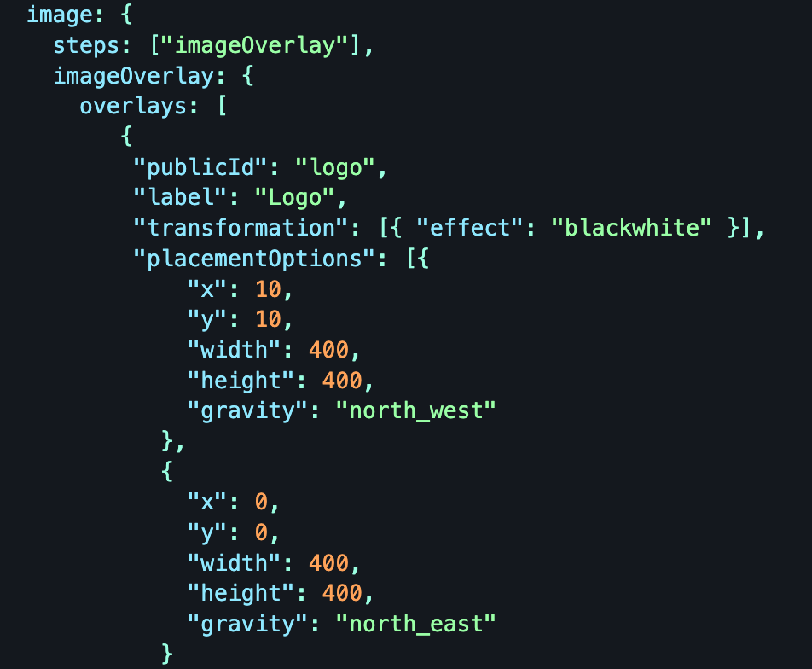
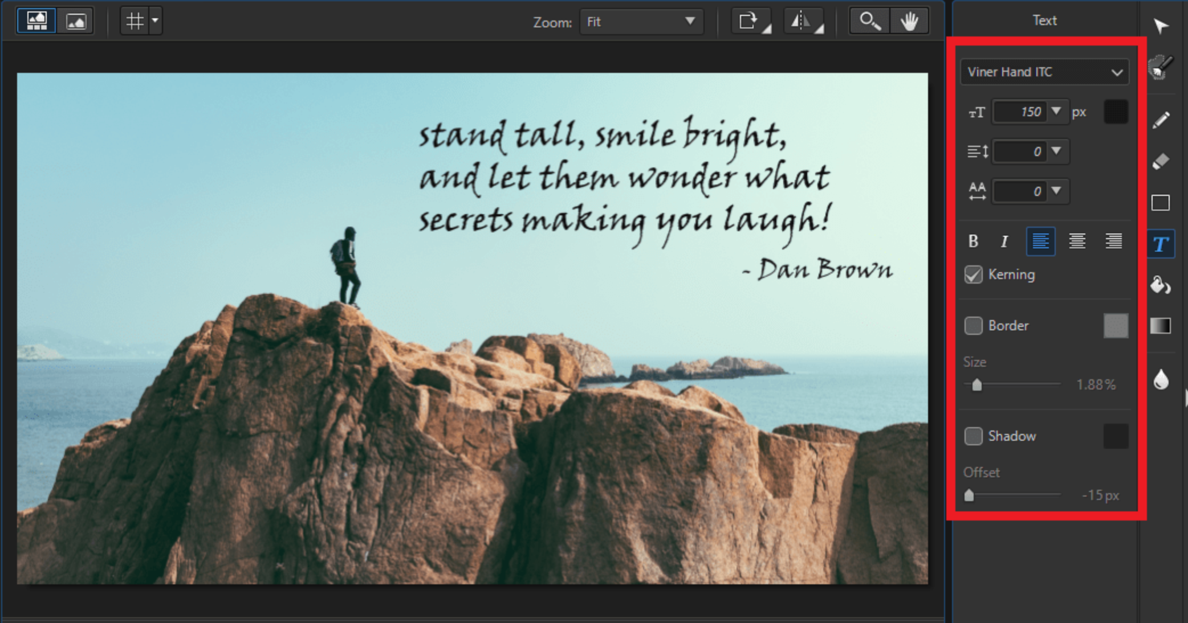
Image Editor with Layers
Intern: Aditya Agrawal Manager: Ayushya Anand
Mentor: Rahul Parihar
Notes:
Make logo box bigger

Slide 2
Overview
The image editor allows clients to send layer information, which is processed to generate
an image. The service is being currently used by Sprinklr from Cloudinary.
This project contains two interconnected projects designed to work together to provide
an image editing service using layers information. The projects are :
JavaServer - A backend service built with Spring Boot.
Js-Puppeteer - A Node.js service using Puppeteer for image generation.

Slide 3
Technology Stack
Java (Spring Boot) : For receiving Layers from client
Node.js : Using Puppeteer generates Image and send back to Java
GRPC - For inter-service communication
Puppeteer - For generating images using layer information (Developer Tool)

Slide 4
Complete Flow
JsPuppeteer
Html string
Image Bytes
JavaServer
JsPuppeteer
Html string
Initializing browser
Html string
Controller/ ServiceToJS.java
src/index.js
browserInit.js
And pool of Tabs
Layers
Image Bytes
Image Bytes
Client
controller/ RecieveLayers.java
Load Balancer
Browser and Tab Instance
Image Bytes
Image Bytes
Generating image
Layers
grpcRequest
using Html
servicePuppetter.js
Service/ HtmlString.java
Html string
Html String
Image Bytes
Html string
JsPuppeteer
Image Bytes

Slide 5
Time Consumption Distribution

Slide 6
Render HTML time reduction
Layers Contains Images that are to be rendered from browser using given URL !!
Significant time reduction can done if –
Images are first stored in CDNs through frontend and then inserting its URL in Layers.
Using GRPC to fetch Images from CDN.
Other factors contribute very less for rendering time of HTML.

Slide 7
New Tab time
reduction
Browser
Pool of Tabs already opened at the time of
browser launch.
Any request arrived will be assigned one of the
free Tabs.
If no Tab is available, requests will be Queued
and processed as soon as any tab is freed.
Tab 1
Tab 2
Tab 3
Tab 4
Tab 5
Tab 6
Tab 7
Tab 8
Tab 9

Slide 8
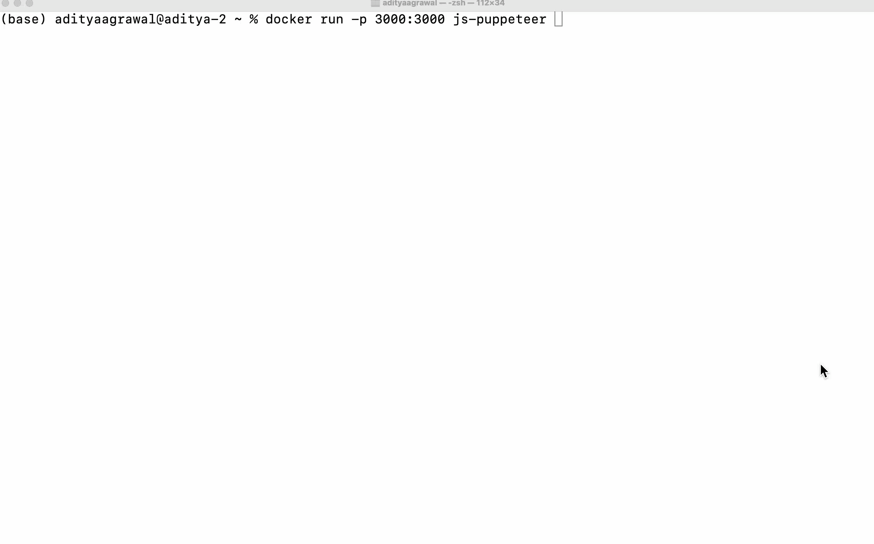
Integration Testing
Single Test Case

Slide 9
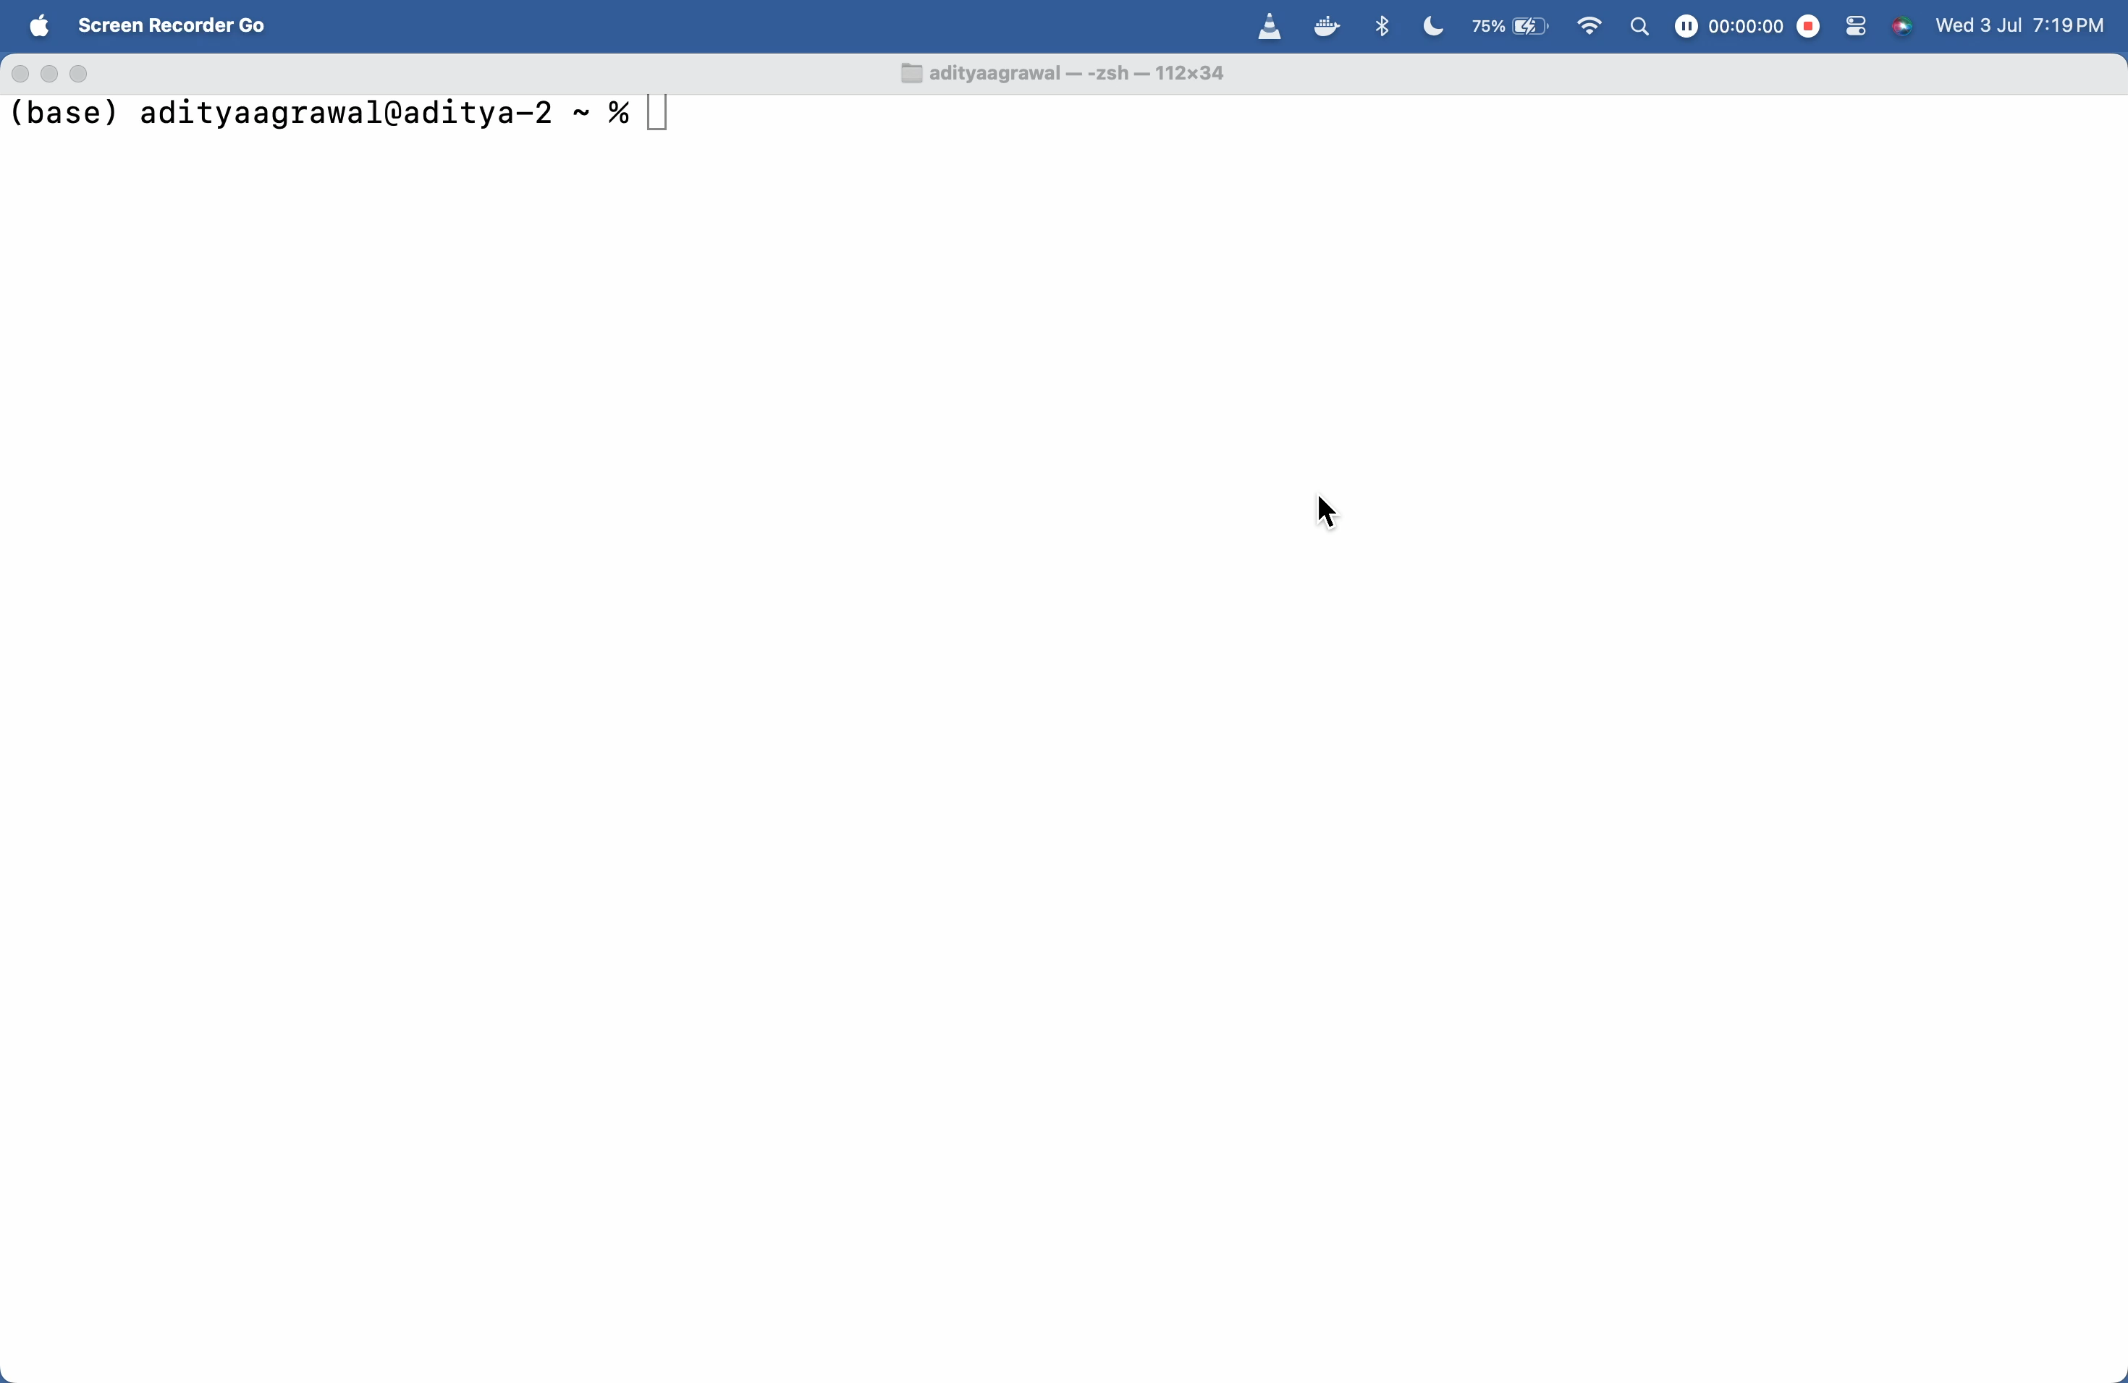
Integration Testing
Multiple Test Cases in Parallel ( 50 )

Slide 10
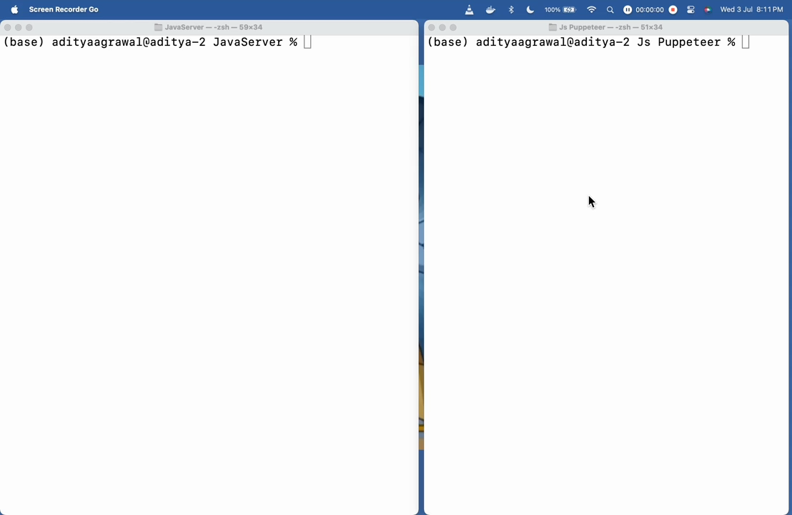
Docker to Docker Testing using Postman

Slide 11
Thankyou

